Slide 1
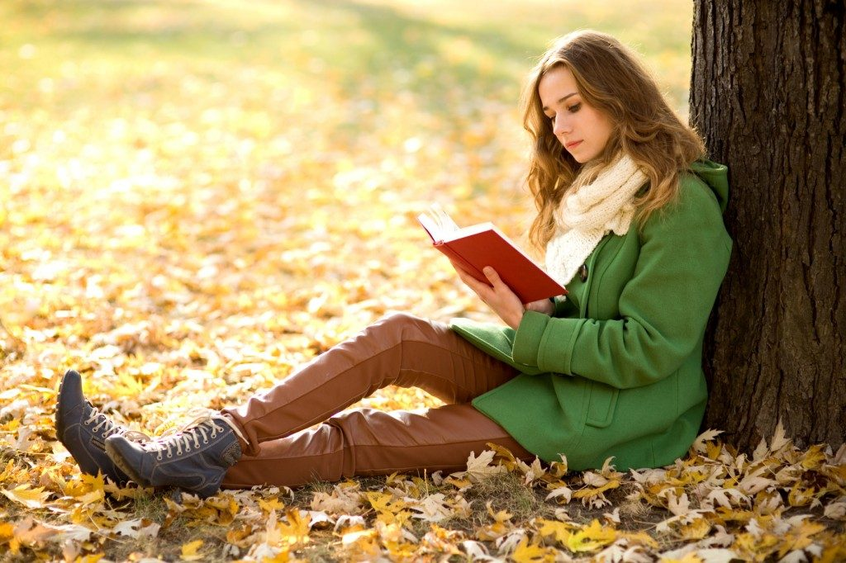
Reading book

Slide 2

Fishing

Slide 3
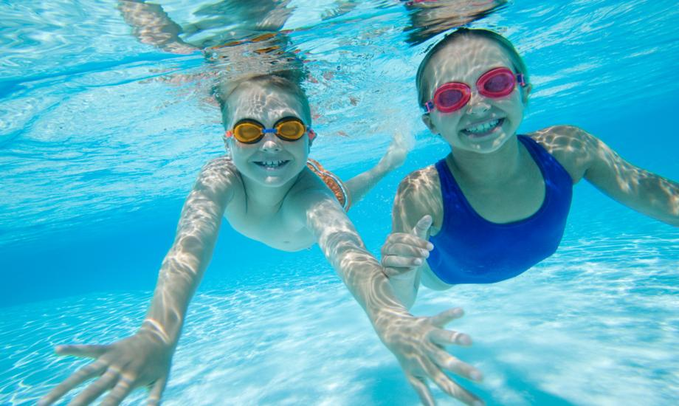
Swimming

Slide 4
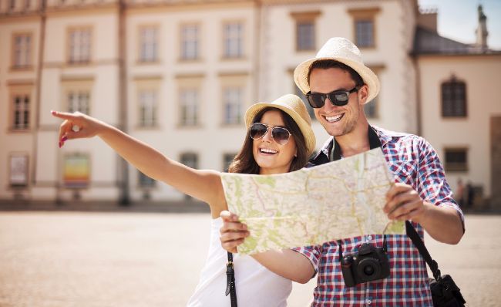
Traveling

Slide 5
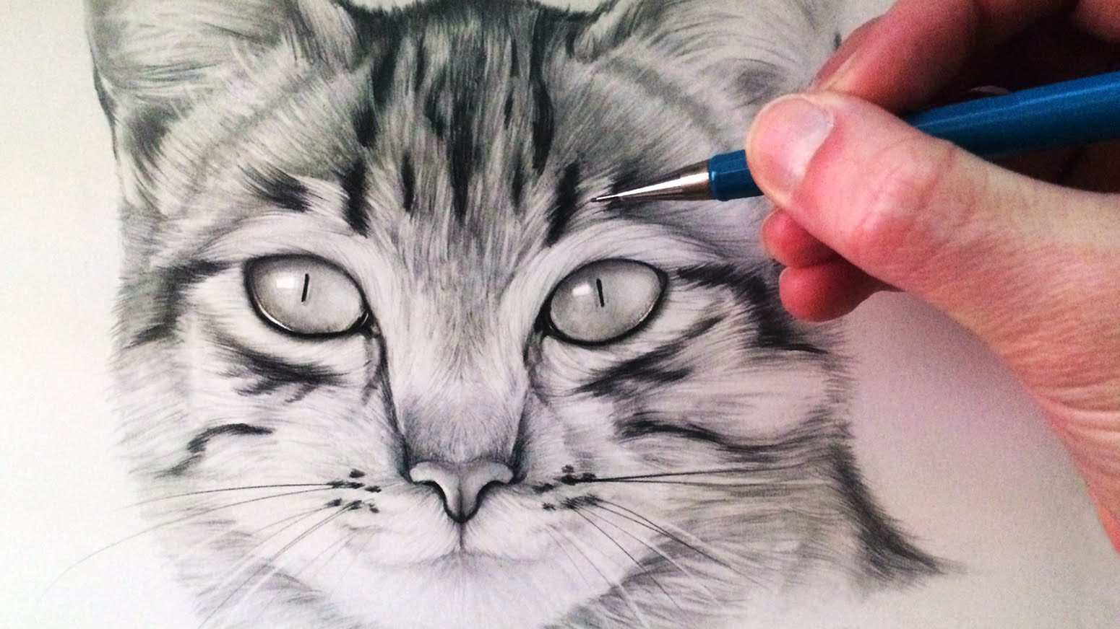
Drawing

Slide 6
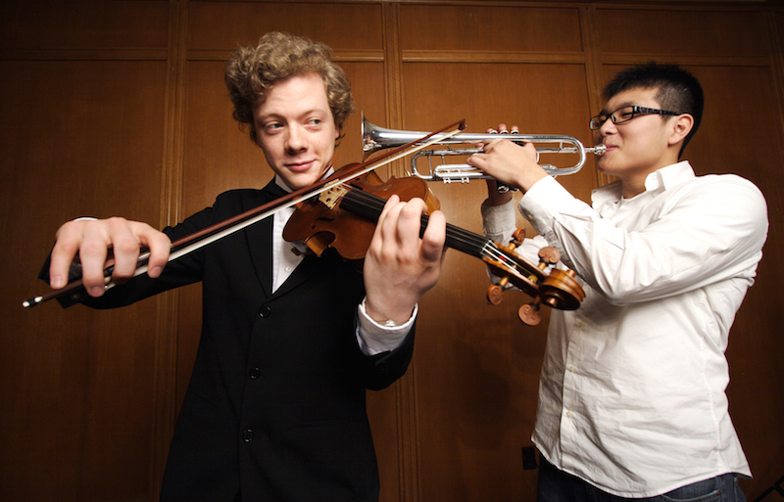
Playing an instrument

Slide 7
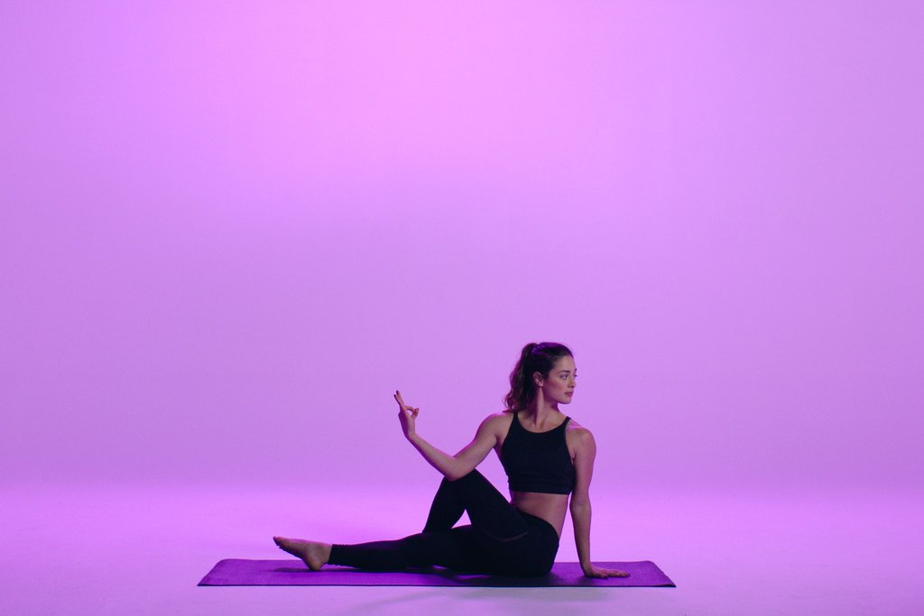
Yoga

Slide 8
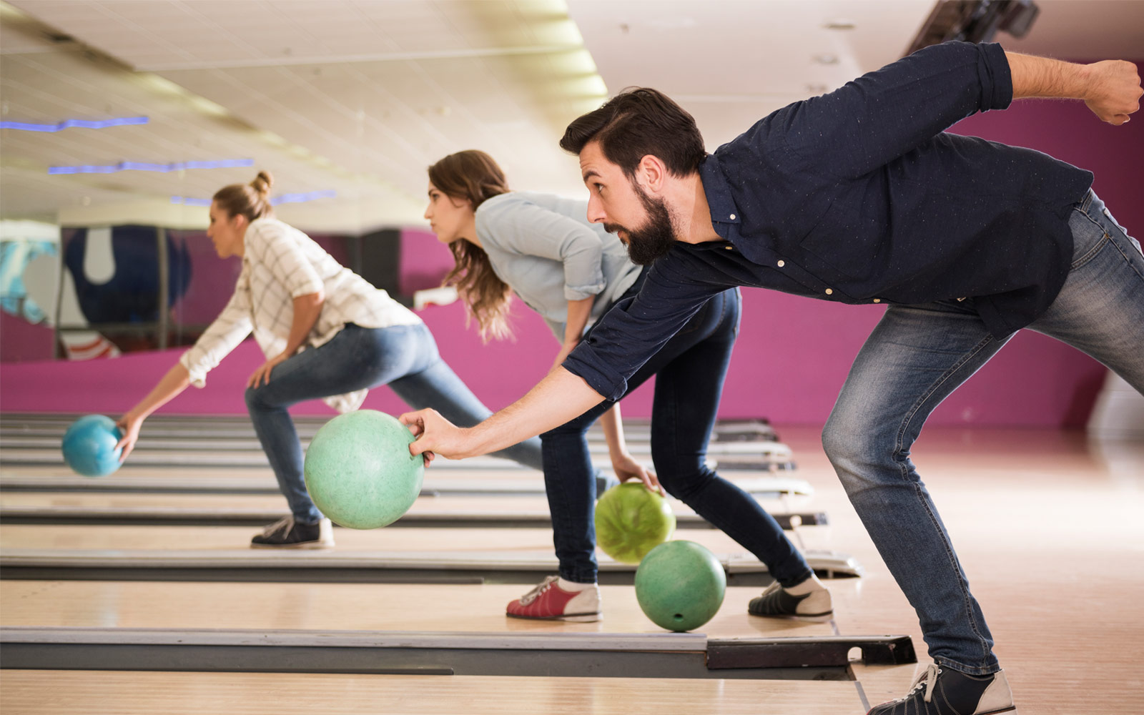
Bowling

Slide 9
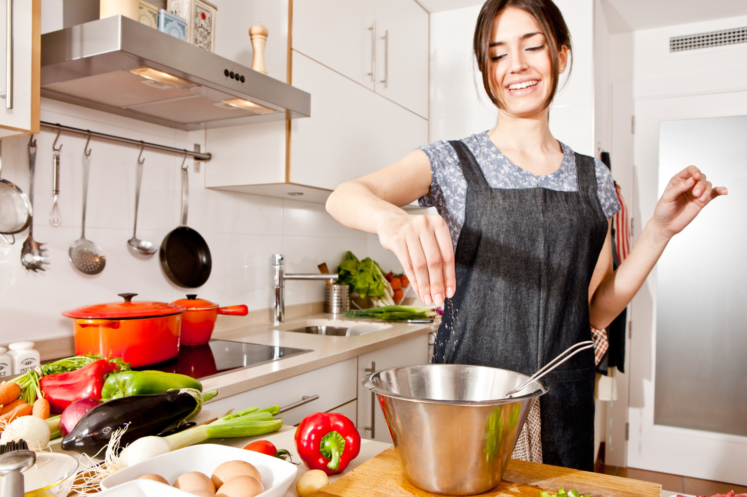
Cooking

Slide 10
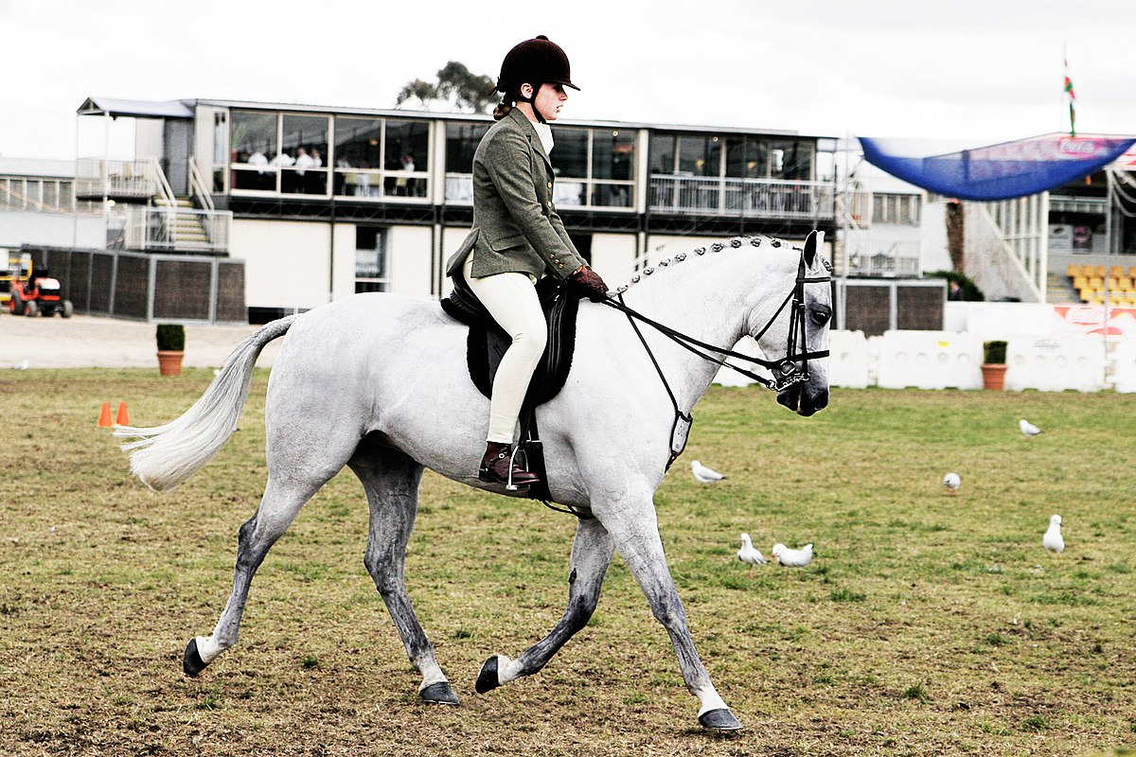
Horseback riding

Slide 11
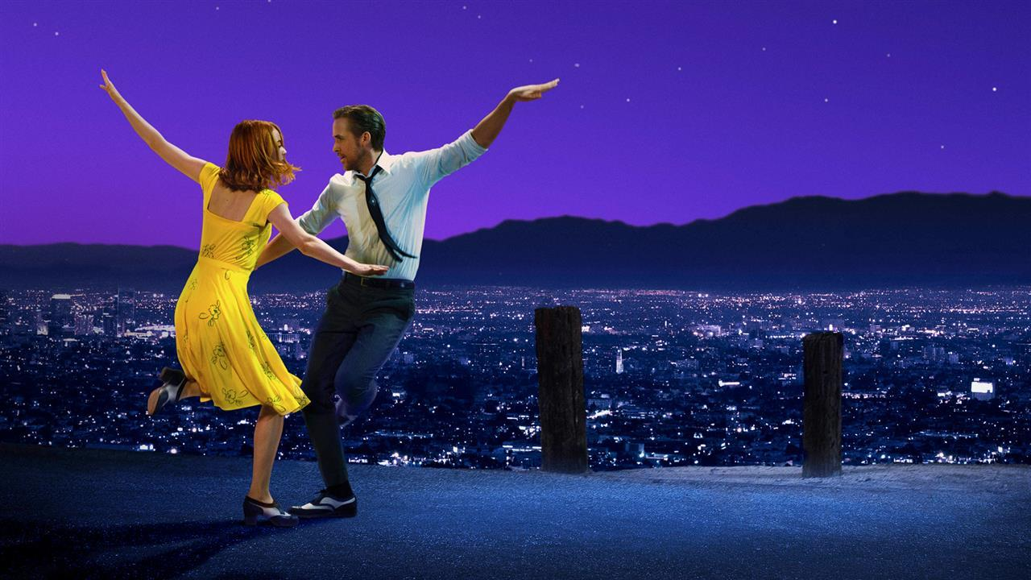
Dancing

Slide 12
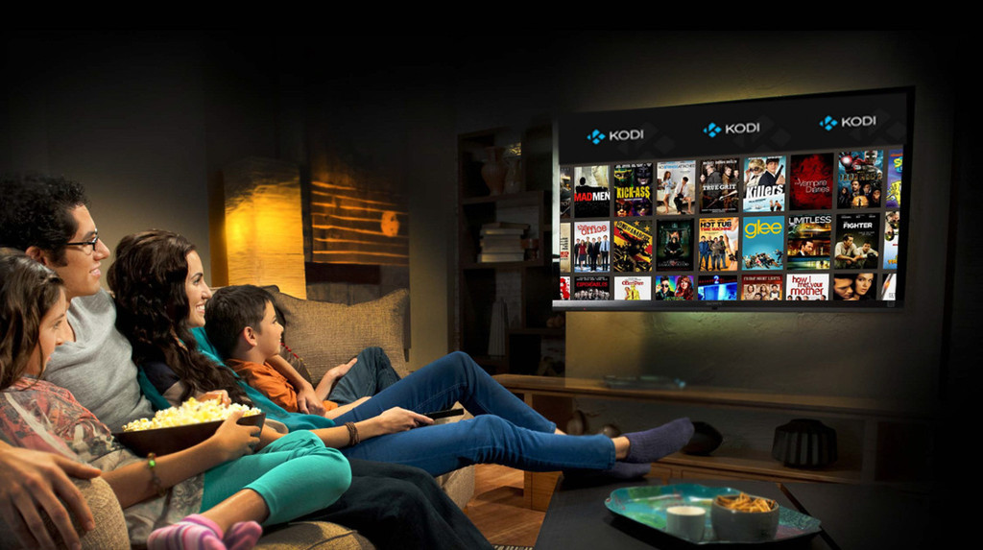
Watching TV

Slide 14
The Lord is my protector

Slide 15
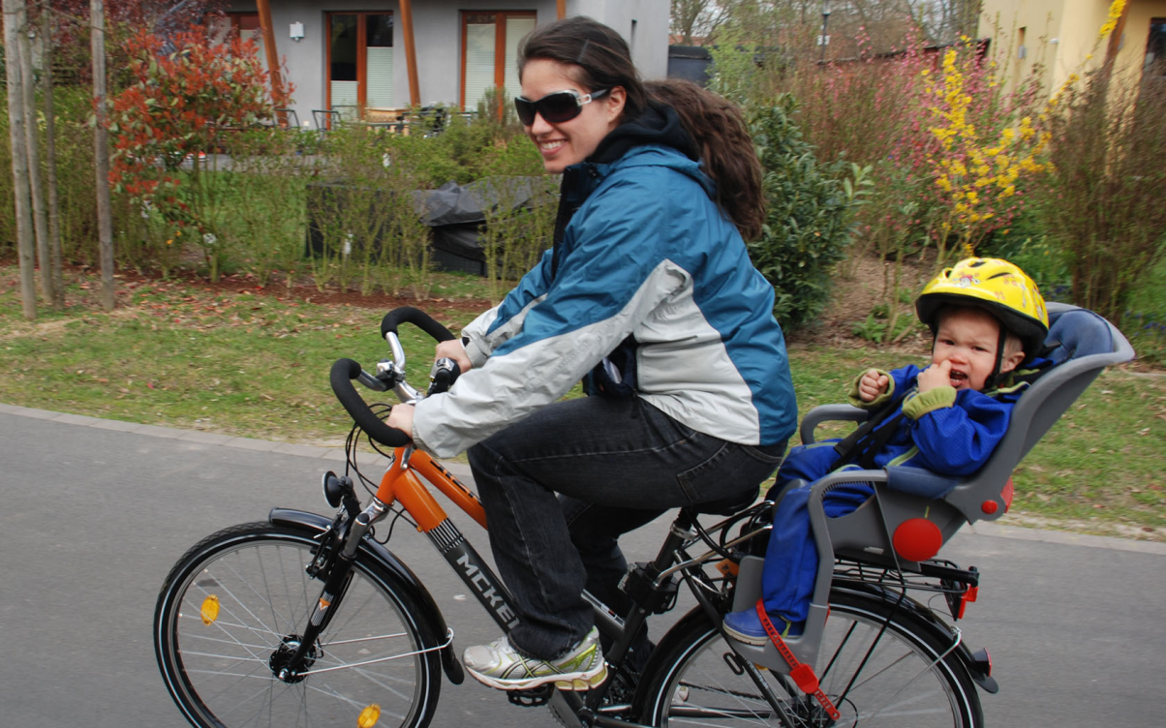
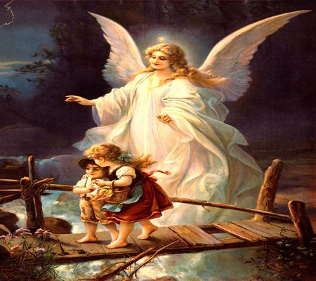

Slide 16
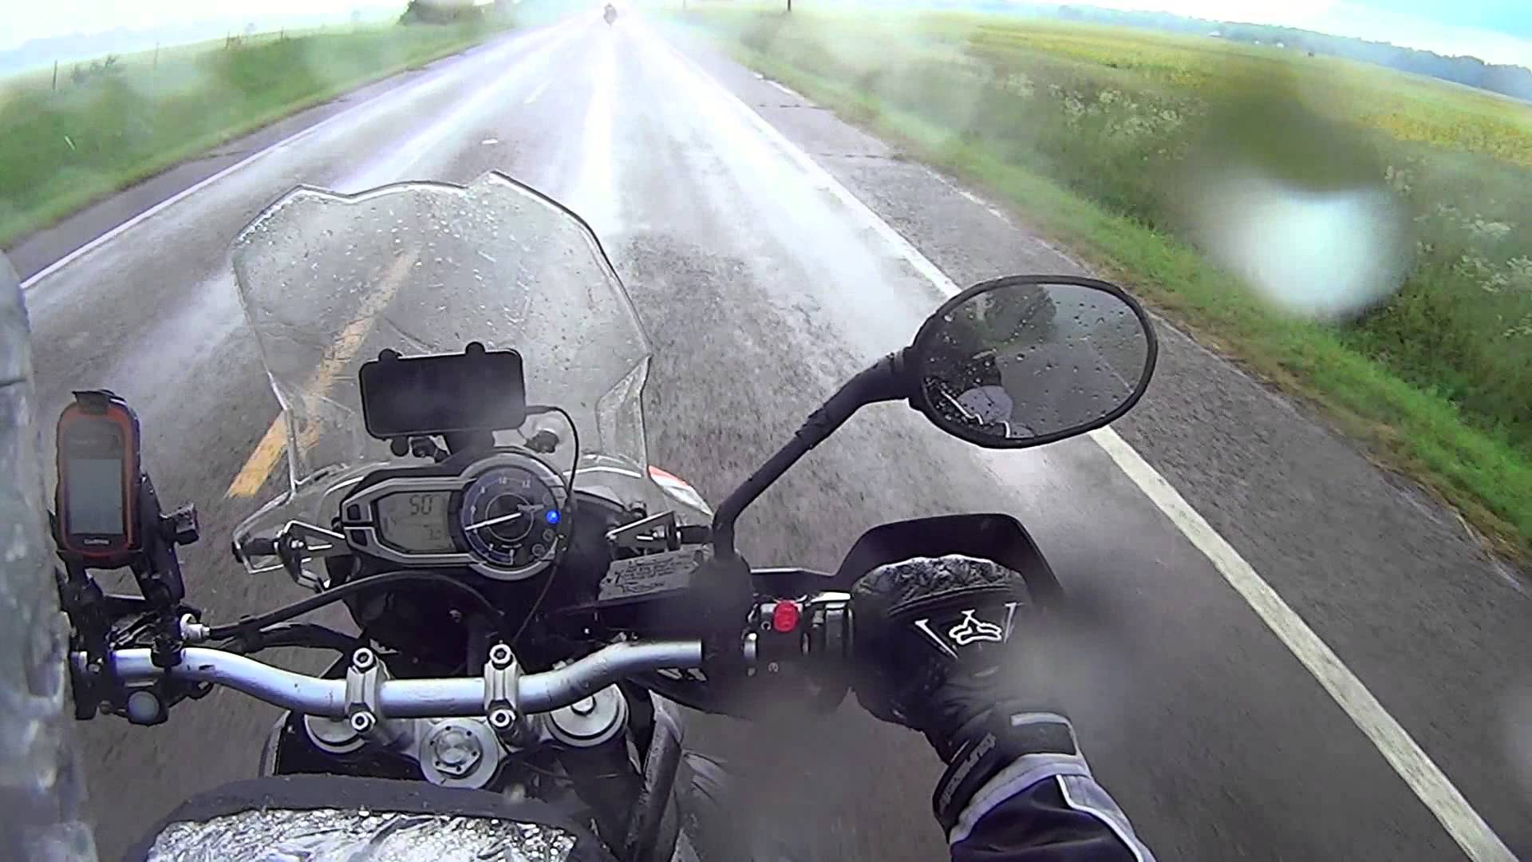

Slide 17
The Lord is my protector
My God is my protection, and with him I am safe
He protects me like a shield, he defends me and keeps me safe.

